Slide 1
SOFTWARE DEFECT PREDICTION USING ML

Slide 2

FACTORS ON WHICH A SOFTWARE’S QUALITY DEPEND ARE:
McCabe’s Cyclomatic Complexity
McCabe’s Essential Complexity
McCabe’s Design Complexity
Halstead Program Vocabulary
Halstead Program Volume
Halstead Program Length
Halstead Difficulty
Halstead Intelligence
Halstead Effort
Halstead Time Estimator

Slide 3
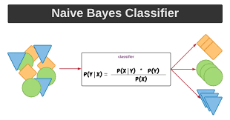
We use a dataset which has instances for different softwares developed and have the values of these factors as features. Based on these features we can find out whether a software has a defect or not.
It has 8799 softwares with no defect and 2106 softwares with defects.
We can use a classification algorithm like Naive Bayes to detect if a software has a bug or not.

Slide 4
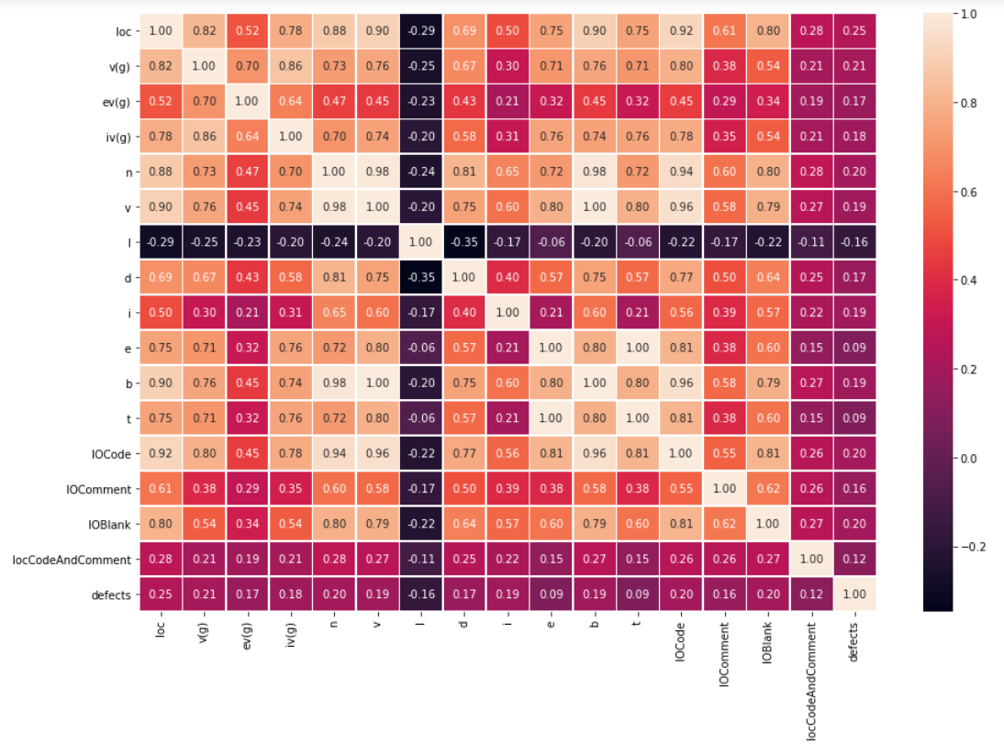
Heat Map for co-variance analysis

Slide 5
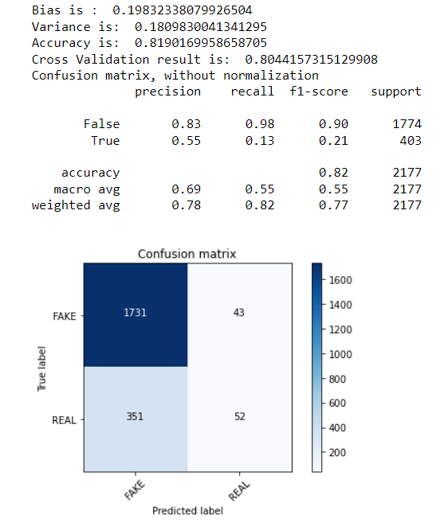
RESULTS AND REVIEW

